Slide 1




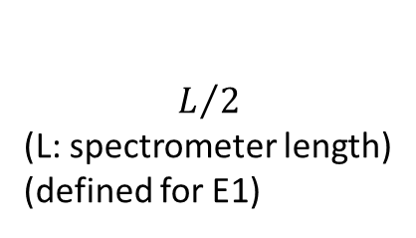
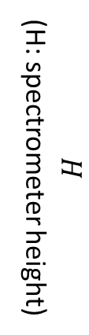


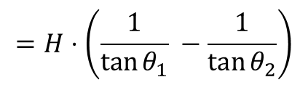
$$E_{1}>E_{2}$$
$$φ=θ_{2}−θ_{1}=\arcsin{\frac{n h c}{2d E_{2}}}−\arcsin{\frac{n h c}{2d E_{1}}}$$
$$φ$$
$$H$$
(H: spectrometer height)
$$=H⋅\left(\frac{1}{\tan{θ_{1}}} −\frac{1}{\tan{θ_{2}}}\right)$$
crystal length
$$θ_{2}$$
$$θ_{1}$$
$$L/2$$ (L: spectrometer length) (defined for E1)
$$L=\frac{2⋅H}{tan⁡(θ_{1})}$$

Slide 2






Geometry 1
ions
$$dist$$
laser
$$θ_{1}$$
$$φ$$
sample length
$$θ_{2}$$
$$θ_{1}$$
$$=\left(\tan\left(θ_{1}+φ\right)−\tan\left(θ_{1}\right)\right)⋅dist$$

Slide 3
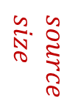


Geometry 1
ions
$$dist$$
laser
$$source \\ size$$
$$θ_{1}$$
$$φ$$
sample length
$$θ_{2}$$
$$θ_{1}$$
$Δ$ sample length = source size
$$=\left(\tan\left(θ_{1}+φ\right)−\tan\left(θ_{1}\right)\right)⋅dist$$
(also some $Δ$ crystal length)

Slide 4

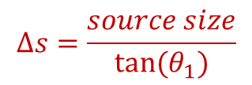


Geometry 1
$$Δs=\frac{source size}{tan⁡(θ_{1})}$$
ions
laser
$$θ_{1}$$
$$source \\ size$$
$$φ$$
$$θ_{2}$$
$$θ_{1}$$
$$θ_{1}$$
$Δs$ equally on crystal and detector

Slide 5






Geometry 2
laser
$$source \\ size$$
$$φ$$
ions
$$α$$
$$dist$$
.
$$=2 tan\left(\frac{φ}{2}\right)∗dist$$
sample length
$$α$$
$Δ$ sample length = source size
$$θ_{2}$$
$$θ_{1}$$
(also some $Δ$ crystal length)

Slide 6
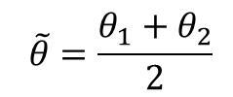





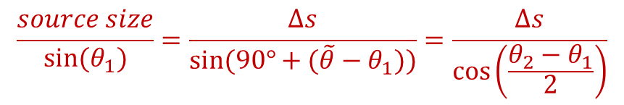


Geometry 2
$$\frac{source size}{sin(θ_{1})}=\frac{Δs}{sin⁡(90°+(\tilde{θ}−θ_{1}))}=\frac{Δs}{\cos\left(\frac{θ_{2}−θ_{1}}{2}\right)}$$
laser
$$source \\ size$$
$$Δs$$
$$\tilde{θ}$$
$$θ_{1}$$
$$90°−\tilde{θ}$$
$$φ$$
ions
$$α$$
.
$$=2 tan\left(\frac{φ}{2}\right)∗dist$$
sample length
$$α$$
$$θ_{2}$$
$$\tilde{θ}$$
$$θ_{1}$$
$$θ_{1}$$
$$\tilde{θ}=\frac{θ_{1}+θ_{2}}{2}$$
(from suitable „Vierecken“):
$$I:360°=90°+\left(180°−α\right)+θ_{1}+\left(180°−\tilde{θ}\right) \\ II:360°=90°+\tilde{θ}+ \left(180°−θ_{2}\right)+\left(180°−α\right)$$
$Δs$ equally on crystal and detector

Slide 7
Some basic conditions for the spectrometer:
use GE cams -> 27 mm detector size -> 13.5 mm crystal length
this determines, in dependence of the lattice constant: the height and length of the spectrometer
27mm on detector equal 150 eV and a resolution of around 1eV is desired
von Hamos would be beneficial for signal strength, spatial imaging
Some basic conditions for target assembly:
sample length not more than 1mm
distance from backlighter to sample not less than 3mm
Space:
there needs to be space for shielding of camera
there needs to be space for magnet in front of spectrometer

Slide 8
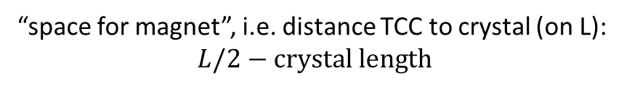



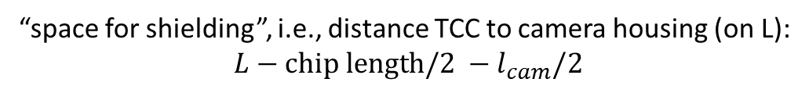

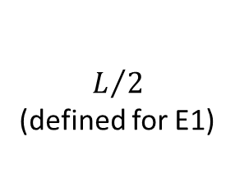
Some distance calculations (directly usable for geo 1. for geo 2 keep ion incidence angle in mind)
“space for shielding”, i.e., distance TCC to camera housing (on L):
$$L−chip length/2 −l_{cam}/2$$
chip length
$$l_{cam}$$
$$H$$
crystal length
$$θ_{2}$$
$$θ_{1}$$
“space for magnet”, i.e. distance TCC to crystal (on L):
$$L/2−crystal length$$
$$L/2$$ (defined for E1)

Slide 9







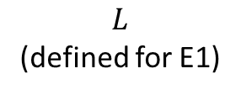
Geometry 2
clearance $=\tan\left(90°−\tilde{θ}\right)⋅\left(L−\frac{chip length}{2}−offset\right)−h_{cam}$
offset
$$h_{cam}$$
chip length
laser
ions
$$l_{cam}$$
.
$$\tilde{θ}=\frac{θ_{1}+θ_{2}}{2}$$
$$H$$
$$θ_{2}$$
$$\tilde{θ}$$
$$θ_{1}$$
$$L$$ (defined for E1)

Slide 10
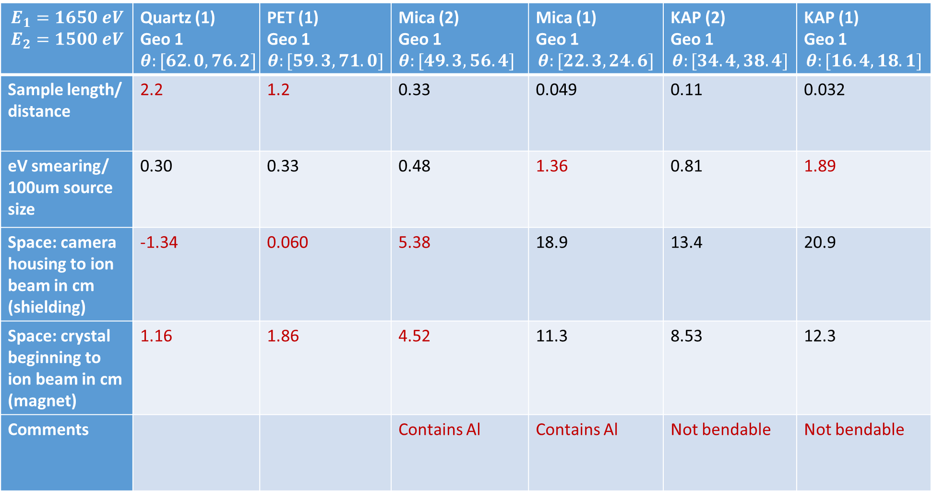
$$E_{1}=1650 eV$$ $$E_{2}=1500 eV$$ | Quartz (1) Geo 1 $$θ:[62.0, 76.2]$$ | PET (1) Geo 1 $$θ:[59.3, 71.0]$$ | Mica (2) Geo 1 $$θ:[49.3, 56.4]$$ | Mica (1) Geo 1 $$θ:[22.3, 24.6]$$ | KAP (2) Geo 1 $$θ:[34.4, 38.4]$$ | KAP (1) Geo 1 $$θ:[16.4, 18.1]$$
Sample length/ distance | 2.2 | 1.2 | 0.33 | 0.049 | 0.11 | 0.032
eV smearing/ 100um source size | 0.30 | 0.33 | 0.48 | 1.36 | 0.81 | 1.89
Space: camera housing to ion beam in cm (shielding) | -1.34 | 0.060 | 5.38 | 18.9 | 13.4 | 20.9
Space: crystal beginning to ion beam in cm (magnet) | 1.16 | 1.86 | 4.52 | 11.3 | 8.53 | 12.3
Comments |  |  | Contains Al | Contains Al | Not bendable | Not bendable

Slide 11
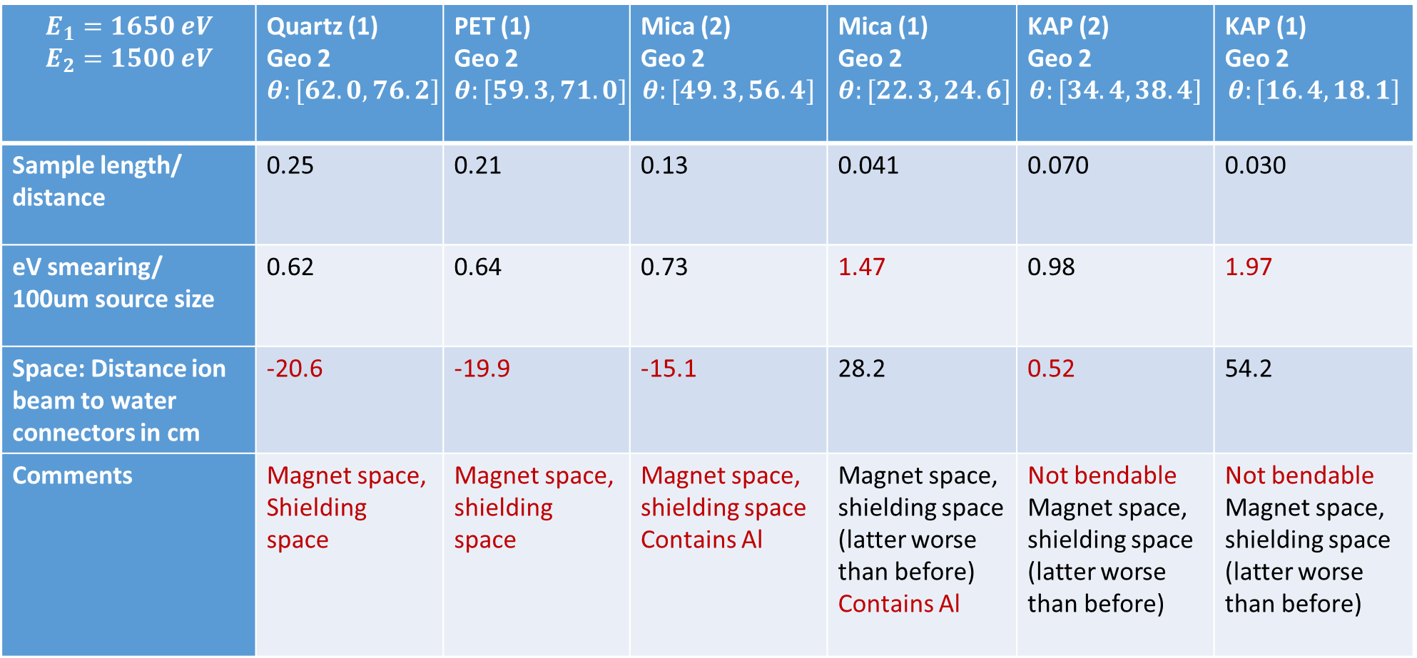
$$E_{1}=1650 eV$$ $$E_{2}=1500 eV$$ | Quartz (1) Geo 2 $$θ:[62.0, 76.2]$$ | PET (1) Geo 2 $$θ:[59.3, 71.0]$$ | Mica (2) Geo 2 $$θ:[49.3, 56.4]$$ | Mica (1) Geo 2 $$θ:[22.3, 24.6]$$ | KAP (2) Geo 2 $$θ:[34.4, 38.4]$$ | KAP (1) Geo 2 $$θ:[16.4, 18.1]$$
Sample length/ distance | 0.25 | 0.21 | 0.13 | 0.041 | 0.070 | 0.030
eV smearing/ 100um source size | 0.62 | 0.64 | 0.73 | 1.47 | 0.98 | 1.97
Space: Distance ion beam to water connectors in cm | -20.6 | -19.9 | -15.1 | 28.2 | 0.52 | 54.2
Comments | Magnet space, Shielding space | Magnet space, shielding space | Magnet space, shielding space Contains Al | Magnet space, shielding space (latter worse than before) Contains Al | Not bendable Magnet space, shielding space (latter worse than before) | Not bendable Magnet space, shielding space (latter worse than before)
Furthermore, need to make sure that ion beam does not hit camera housing (not only water connectors).

Slide 12
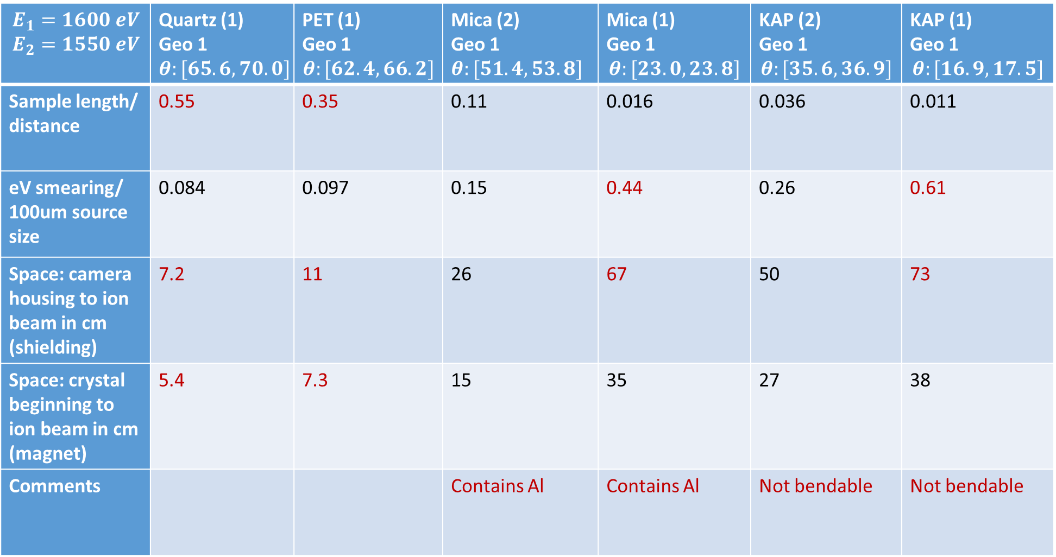
$$E_{1}=1600 eV$$ $$E_{2}=1550 eV$$ | Quartz (1) Geo 1 $$θ:[65.6, 70.0]$$ | PET (1) Geo 1 $$θ:[62.4, 66.2]$$ | Mica (2) Geo 1 $$θ:[51.4, 53.8]$$ | Mica (1) Geo 1 $$θ:[23.0, 23.8]$$ | KAP (2) Geo 1 $$θ:[35.6, 36.9]$$ | KAP (1) Geo 1 $$θ:[16.9,17.5]$$
Sample length/ distance | 0.55 | 0.35 | 0.11 | 0.016 | 0.036 | 0.011
eV smearing/ 100um source size | 0.084 | 0.097 | 0.15 | 0.44 | 0.26 | 0.61
Space: camera housing to ion beam in cm (shielding) | 7.2 | 11 | 26 | 67 | 50 | 73
Space: crystal beginning to ion beam in cm (magnet) | 5.4 | 7.3 | 15 | 35 | 27 | 38
Comments |  |  | Contains Al | Contains Al | Not bendable | Not bendable

Slide 13
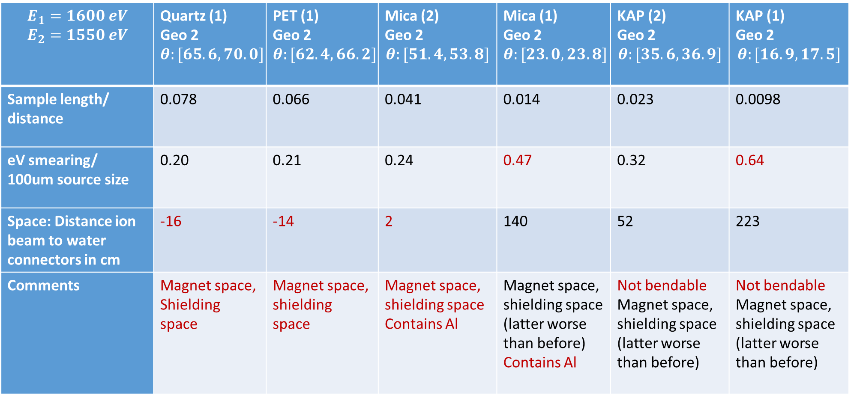
$$E_{1}=1600 eV$$ $$E_{2}=1550 eV$$ | Quartz (1) Geo 2 $$θ:[65.6, 70.0]$$ | PET (1) Geo 2 $$θ:[62.4, 66.2]$$ | Mica (2) Geo 2 $$θ:[51.4, 53.8]$$ | Mica (1) Geo 2 $$θ:[23.0, 23.8]$$ | KAP (2) Geo 2 $$θ:[35.6, 36.9]$$ | KAP (1) Geo 2 $$θ:[16.9,17.5]$$
Sample length/ distance | 0.078 | 0.066 | 0.041 | 0.014 | 0.023 | 0.0098
eV smearing/ 100um source size | 0.20 | 0.21 | 0.24 | 0.47 | 0.32 | 0.64
Space: Distance ion beam to water connectors in cm | -16 | -14 | 2 | 140 | 52 | 223
Comments | Magnet space, Shielding space | Magnet space, shielding space | Magnet space, shielding space Contains Al | Magnet space, shielding space (latter worse than before) Contains Al | Not bendable Magnet space, shielding space (latter worse than before) | Not bendable Magnet space, shielding space (latter worse than before)
Furthermore, need to make sure that ion beam does not hit camera housing (not only water connectors).

Slide 14
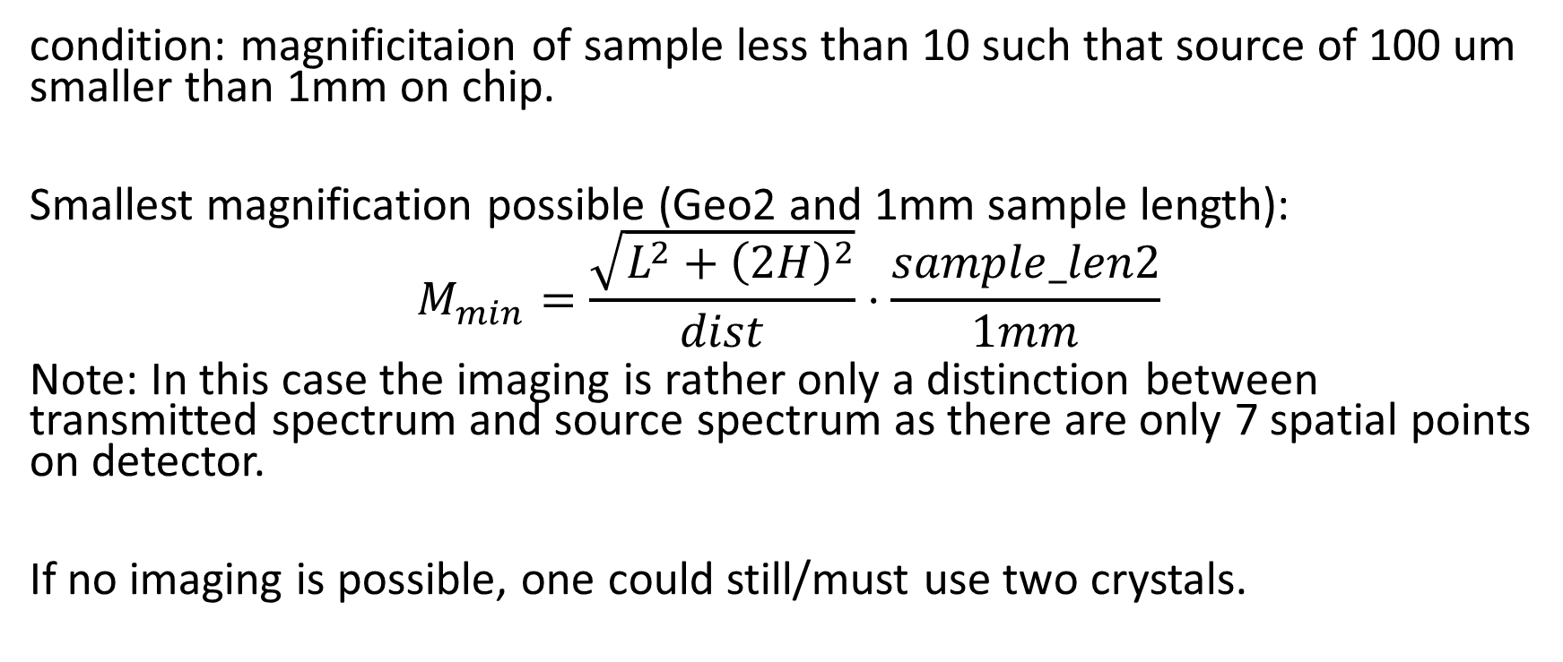
We note that for flat crystals a further criterion is whether point source „imaging“ is possible.
condition: magnificitaion of sample less than 10 such that source of 100 um smaller than 1mm on chip.
Smallest magnification possible (Geo2 and 1mm sample length):
$$M_{min}=\frac{\sqrt{L^{2}+{\left(2H\right)}^{2}}}{dist}⋅\frac{sample_len2}{1mm}$$
Note: In this case the imaging is rather only a distinction between transmitted spectrum and source spectrum as there are only 7 spatial points on detector.
If no imaging is possible, one could still/must use two crystals.

Slide 15
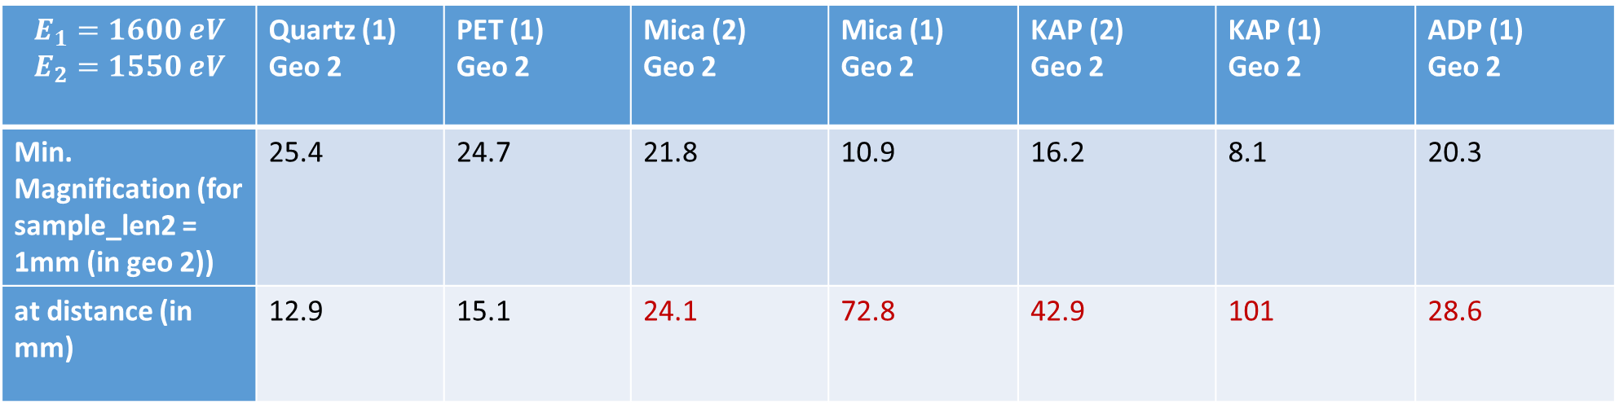
$$E_{1}=1600 eV$$ $$E_{2}=1550 eV$$ | Quartz (1) Geo 2 | PET (1) Geo 2 | Mica (2) Geo 2 | Mica (1) Geo 2 | KAP (2) Geo 2 | KAP (1) Geo 2 | ADP (1) Geo 2
Min. Magnification (for sample_len2 = 1mm (in geo 2)) | 25.4 | 24.7 | 21.8 | 10.9 | 16.2 | 8.1 | 20.3
at distance (in mm) | 12.9 | 15.1 | 24.1 | 72.8 | 42.9 | 101 | 28.6
einzelner flacher Kristall ist raus

Slide 16
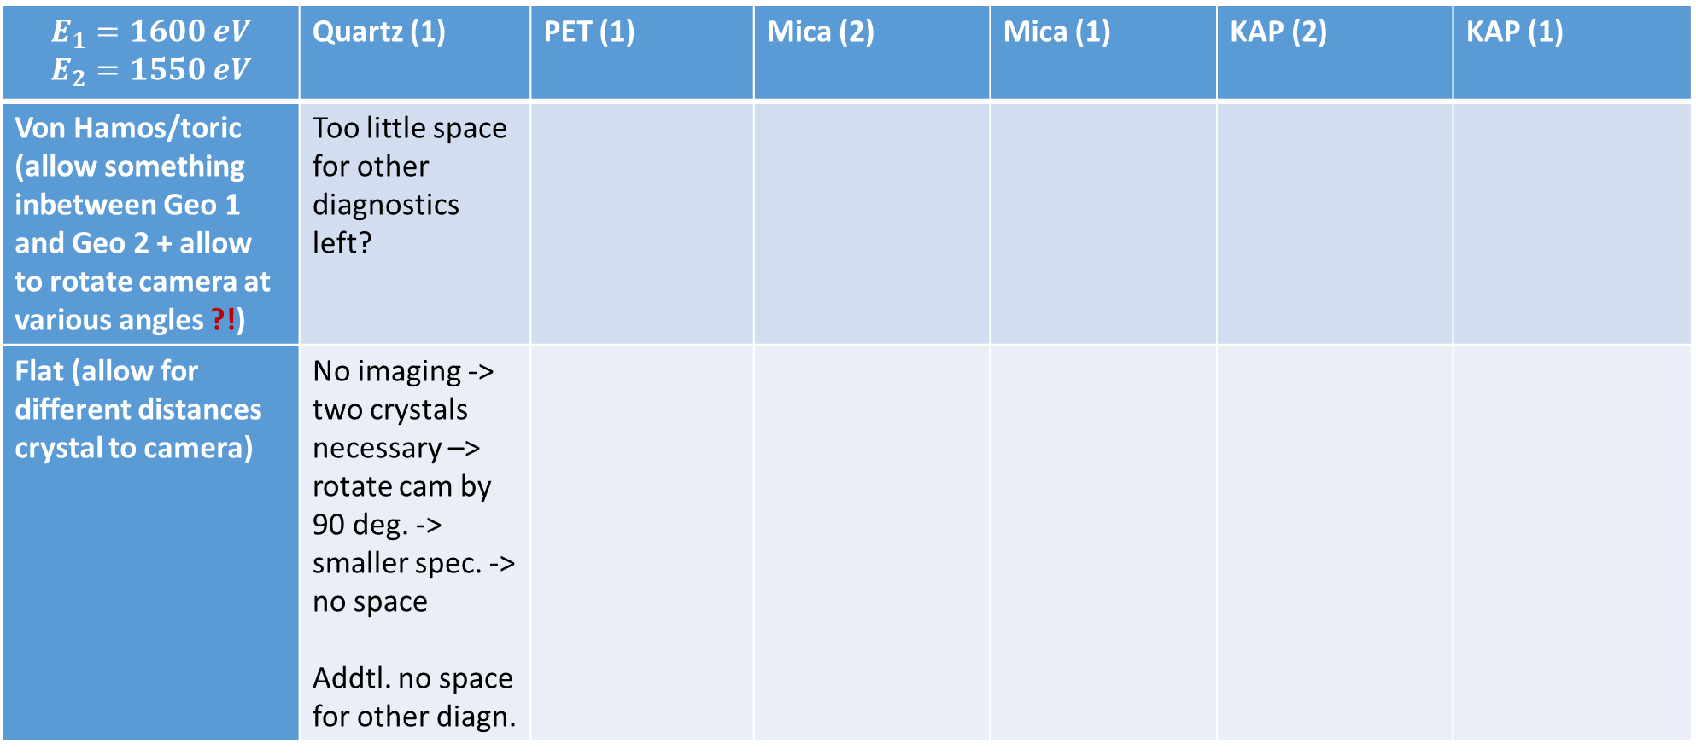
$$E_{1}=1600 eV$$ $$E_{2}=1550 eV$$ | Quartz (1) | PET (1) | Mica (2) | Mica (1) | KAP (2) | KAP (1)
Von Hamos/toric (allow something inbetween Geo 1 and Geo 2 + allow to rotate camera at various angles ?!) | Too little space for other diagnostics left?
Flat (allow for different distances crystal to camera) | No imaging -> two crystals necessary –> rotate cam by 90 deg. -> smaller spec. -> no space Addtl. no space for other diagn.
Rotating camera:
at fixed position does not change spectral broadening from source size as spectrum and source projection change their size the same way
need to take change of spectrum projection size into account
camera chip parallel to backlighter useful if and only if (theta <45 deg and spectrometer size increased)

Slide 17
General ideas:
rotate backlighter such that not magnified (or less magnified) on detector (concerning the source size keep projection of laser on backlighter in mind)
to save some space go out of plane (i.e. giving up space resolution perpendicular to ion beam axis)
Each adaption should be tested for each geometry, i.e.,
geo 1 out of plane, geo 2 out of plane, geo 1 roated backlighter, geo 2 rotated backlighter.
Paul and I only discussed geometry 2 out of plane and geometry 1 rotated backlighter.

Slide 18
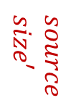
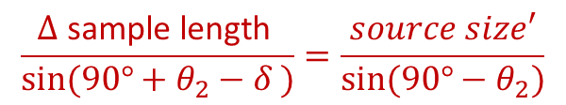

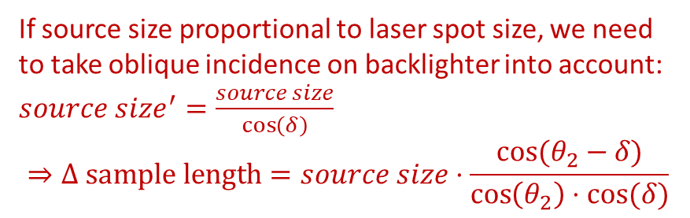

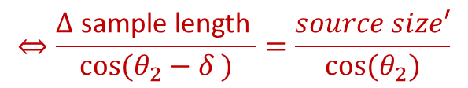


Geometry 1 rotated backlighter
$$\frac{Δ \text{sample} \text{length} }{sin(90°+θ_{2}−δ )}=\frac{source size′}{sin⁡(90°−θ_{2})}$$
ions
$$dist$$
laser
$$⇔\frac{Δ \text{sample} \text{length} }{cos(θ_{2}−δ )}=\frac{source size′}{cos⁡(θ_{2})}$$
$$δ$$
$$θ_{1}$$
$$source \\ size′$$
$$φ$$
If source size proportional to laser spot size, we need to take oblique incidence on backlighter into account:
$source size^{′}=\frac{source size}{\cos\left(δ\right)}$
$$⇒Δ \text{sample} \text{length}=source size⋅\frac{cos⁡(θ_{2}−δ)}{\cos\left(θ_{2}\right)⋅cos⁡(δ)}$$
$$90°+θ_{2}−δ$$
$$90°−θ_{2}$$
sample length
$$θ_{2}$$
$$θ_{1}$$
$Δ$ sample length
$$=\left(\tan\left(θ_{1}+φ\right)−\tan\left(θ_{1}\right)\right)⋅dist$$
(also some $Δ$ crystal length)

Slide 19
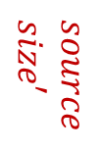

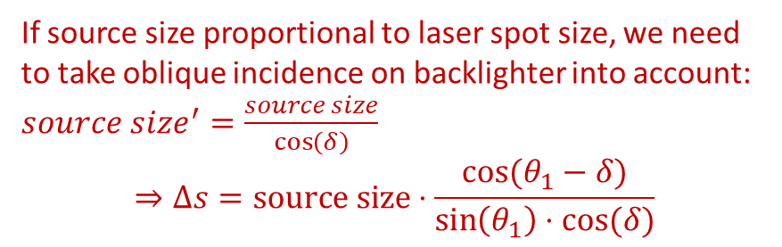
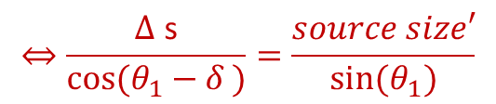
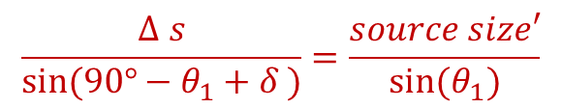


Geometry 1 rotated backlighter
$$\frac{Δ s}{sin(90°−θ_{1}+δ )}=\frac{source size′}{sin⁡(θ_{1})}$$
ions
$$Δs$$
$$dist$$
laser
$$⇔\frac{Δ \text{s}}{cos(θ_{1}−δ )}=\frac{source size′}{sin⁡(θ_{1})}$$
$$θ_{1}$$
$$δ$$
$$θ_{1}$$
$$φ$$
$$source \\ size′$$
If source size proportional to laser spot size, we need to take oblique incidence on backlighter into account:
$source size^{′}=\frac{source size}{\cos\left(δ\right)}$
$$⇒Δs=source size⋅\frac{\cos{(θ_{1}−δ)}}{\sin\left(θ_{1}\right)⋅cos⁡(δ)}$$
$$90°−θ_{1}+δ$$
$$90°+θ_{1}−δ$$
$$θ_{2}$$
$$θ_{1}$$
$$θ_{1}$$
(also some $Δ$ crystal length)

Slide 20



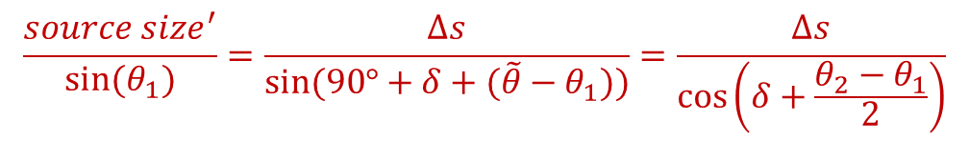

Geometry 2 rotated backlighter
$$\frac{source size^{′}}{sin(θ_{1})}=\frac{Δs}{sin⁡(90°+δ+(\tilde{θ}−θ_{1}))}=\frac{Δs}{\cos\left(δ+\frac{θ_{2}−θ_{1}}{2}\right)}$$
laser
$$source \\ size′$$
$$Δs$$
$$\tilde{θ}$$
$$θ_{1}$$
$$φ$$
If source size proportional to laser spot size, we need to take oblique incidence on backlighter into account:
$source size^{′}=\frac{source size}{\cos\left(δ\right)}$
$$⇒Δs=source size⋅\frac{\cos\left(δ+\frac{θ_{2}−θ_{1}}{2}\right)}{\sin\left(θ_{1}\right)⋅cos⁡(δ)}$$
ions
$$90°−\tilde{θ} −δ$$
$$90°+δ$$
$$α$$
.
$$α$$
$$θ_{2}$$
$$\tilde{θ}$$
$$θ_{1}$$
$$θ_{1}$$
$$\tilde{θ}=\frac{θ_{1}+θ_{2}}{2}$$
(from suitable „Vierecken“):
$$I:360°=90°+\left(180°−α\right)+θ_{1}+\left(180°−\tilde{θ}\right) \\ II:360°=90°+\tilde{θ}+ \left(180°−θ_{2}\right)+\left(180°−α\right)$$
$Δs$ equally on crystal and detector

Slide 21
All in all, rotating the backlighter does not seem to reliably decrease delta s.

Slide 22
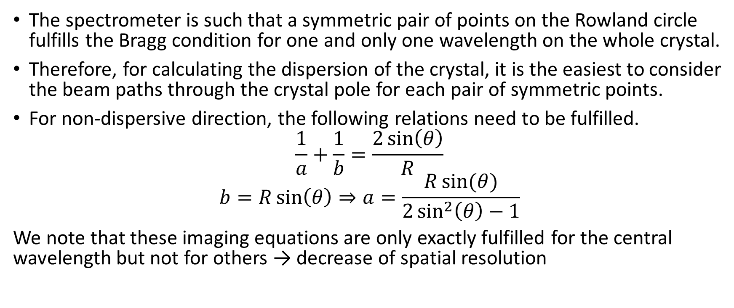
Another idea: FSSR-1D spectrometer
The spectrometer is such that a symmetric pair of points on the Rowland circle fulfills the Bragg condition for one and only one wavelength on the whole crystal.
Therefore, for calculating the dispersion of the crystal, it is the easiest to consider the beam paths through the crystal pole for each pair of symmetric points.
For non-dispersive direction, the following relations need to be fulfilled.
$$\frac{1}{a}+\frac{1}{b}=\frac{2\sin\left(θ\right)}{R}$$
$$b=R\sin\left(θ\right)⇒a=\frac{R\sin{(θ)}}{2\sin^{2}\left(θ\right)−1}$$
We note that these imaging equations are only exactly fulfilled for the central wavelength but not for others → decrease of spatial resolution

Slide 23





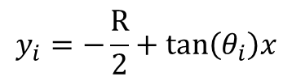



$$E_{1}=1650 eV$$
$$E_{2}=1500 eV$$
$$y_{c}=\sqrt{{\left(\frac{R}{2}\right)}^{2}−x^{2}}$$
R/2
$$0$$
detector with $ζ_{d}$ as transformed coordinate
$$(x_{s},y_{s})$$
$$ζ_{d}$$
($y_{t}$ untransformed)
$$b_{0}$$
(0,0)
$$y_{i}=−\frac{R}{2}+tan\left(θ_{i}\right)x$$
Attention! Only approximation as „Ankunftspunkt“ on Rowland circle is same for one wavelength for all refl. points from crystal, but chip is not bent like Rowland circle
crystal with curv. radius R

Slide 24
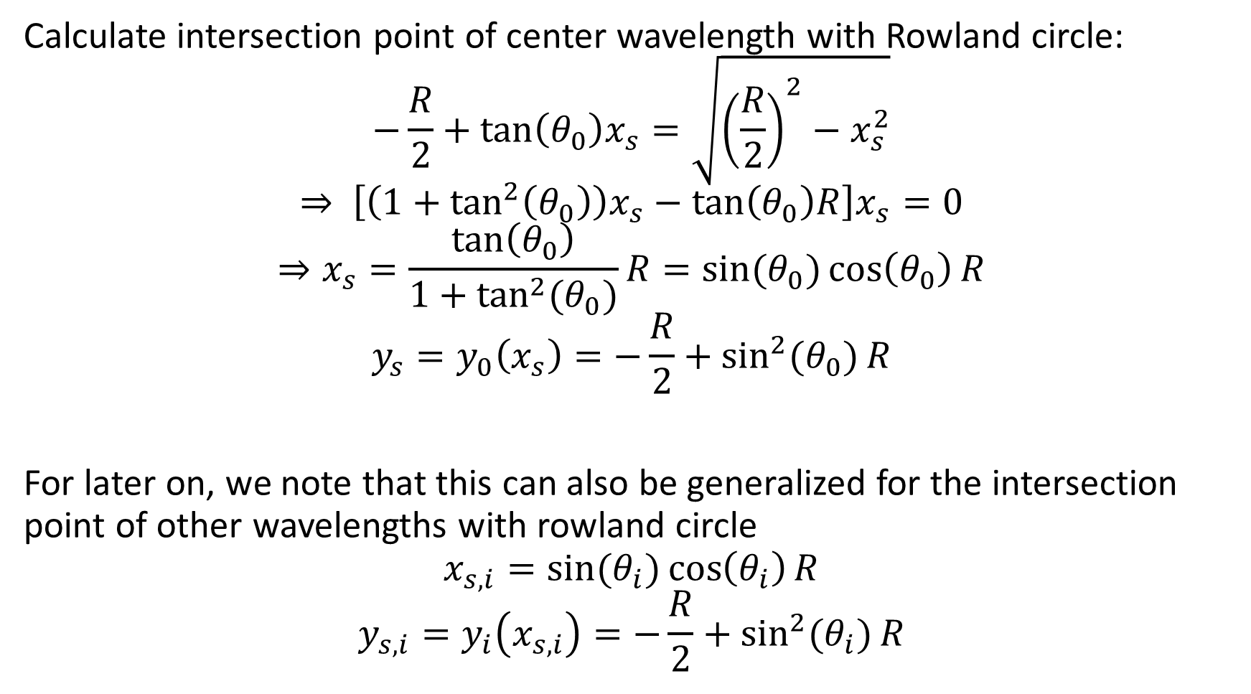
Calculate intersection point of center wavelength with Rowland circle:
$$−\frac{R}{2}+\tan\left(θ_{0}\right)x_{s}=\sqrt{{\left(\frac{R}{2}\right)}^{2}−x_{s}^{2}}$$
$$⇒ \left[\left(1+\tan^{2}\left(θ_{0}\right)\right)x_{s}−\tan\left(θ_{0}\right)R\right]x_{s}=0$$
$$⇒x_{s}=\frac{\tan\left(θ_{0}\right)}{1+\tan^{2}{(θ_{0})}}R=\sin{(θ_{0})}\cos\left(θ_{0}\right)R$$
$$y_{s}=y_{0}\left(x_{s}\right)=−\frac{R}{2}+\sin^{2}{(θ_{0})}R$$
For later on, we note that this can also be generalized for the intersection point of other wavelengths with rowland circle
$$x_{s,i}=\sin{(θ_{i})}\cos\left(θ_{i}\right)R$$
$$y_{s,i}=y_{i}\left(x_{s,i}\right)=−\frac{R}{2}+\sin^{2}{(θ_{i})}R$$

Slide 25
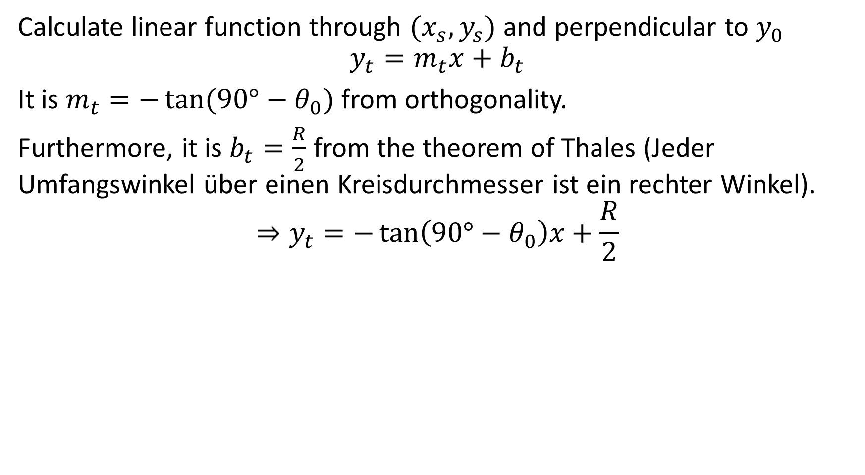
Calculate linear function through $(x_{s}, y_{s})$ and perpendicular to $y_{0}$
$$y_{t}=m_{t}x+b_{t}$$
It is $m_{t}=−\tan{(90°−θ_{0})}$ from orthogonality.
Furthermore, it is $b_{t}=\frac{R}{2}$ from the theorem of Thales (Jeder Umfangswinkel über einen Kreisdurchmesser ist ein rechter Winkel).
$$⇒y_{t}=−\tan\left(90°−θ_{0}\right)x+\frac{R}{2}$$

Slide 26











Transform $y_{t}$ to $χ_{d}$
Intersection point of $y_{i}$ and $y_{t}$
$$−\frac{R}{2}+tan\left(θ_{i}\right)x_{d}=−\tan\left(90°−θ_{0}\right)x_{d}+\frac{R}{2}$$
$$⇒x_{d}=\frac{R}{\tan\left(θ_{i}\right)+\tan{(90° −θ_{0})}}$$
$$⇒ζ_{d}=\frac{\frac{R}{\tan\left(θ_{i}\right)+\tan{(90° −θ_{0})}}−\sin\left(θ_{0}\right)\cos\left(θ_{0}\right)R}{sin⁡(θ_{0})}$$
$$=R\left(\frac{1}{\sin\left(θ_{0}\right)\tan\left(θ_{i}\right)+cos⁡(θ_{0})}−cos⁡(θ_{0})\right)$$
$$0$$
$$(x_{s},y_{s})$$
$$θ_{0}$$
$$ζ_{d}=\frac{x_{d}−x_{s}}{\sin{(θ_{0})}}$$
$$θ_{0}$$
$$θ_{i}$$
$$x_{s}$$
$$x_{d}$$
$$x$$

Slide 27











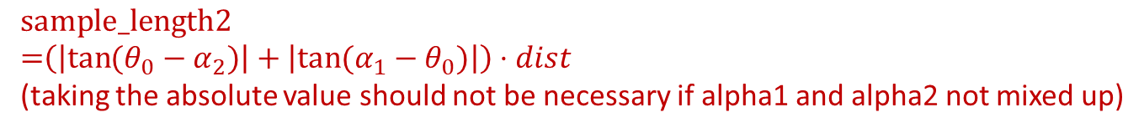


Finally, let us consider the necessary source size in case of FSSR-1d
$$\cos{(θ_{0})}⋅a_{0}−x_{s,2}$$
$$α_{1}$$
$$α_{2}$$
$$dist$$
$$\sin{(θ_{0})}⋅a_{0}−y_{s,2}−R/2$$
$$\text{sample}\text{_}\text{length}\text{1=}\left(\tan\left(α_{1}\right)−tan⁡(α_{2})\right)⋅dist$$
.
$$\text{sample}\text{_}\text{length}\text{2}$$ $\text{=}\left(\left|\tan{(θ_{0}−α_{2})}\right|+\left|\tan{(α_{1}−θ_{0})}\right|\right)⋅dist$ (taking the absolute value should not be necessary if alpha1 and alpha2 not mixed up)
$$dist$$
$$a_{0}$$
$$(−x_{s,2},y_{s,2})$$
$$α_{i}=\arctan\left(\frac{\sin\left(θ_{0}\right)⋅a_{0}−y_{s,i}−R/2}{\cos\left(θ_{0}\right)⋅a_{0}−x_{s,i}}\right)$$
(in Skizze beispielhaft für i=2) Note that $α_{i}$ and therefore sample_length1 and sample_length2 are independent of R
Be careful, for negative $a_{0}$ strange things happen for $α_{i}$
$$\sin{(θ_{0})⋅a_{0}}$$
$$(−x_{s,1},y_{s,1})$$
(0,0)
$$θ_{0}$$
$$\cos\left(θ_{0}\right)⋅a_{0}$$

Slide 28


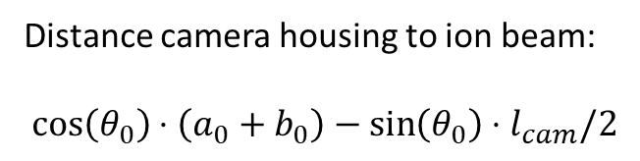

Geometry 1
ions
Distance camera housing to ion beam:
$$\cos\left(θ_{0}\right)⋅\left(a_{0}+b_{0}\right)−\sin\left(θ_{0}\right)⋅l_{cam}/2$$
$$h_{cam}$$
offset
$$a_{0}$$
$$\sin{(θ_{0})⋅a_{0}}$$
$$l_{cam}$$
$$b_{0}$$
$$θ_{0}$$
$$\cos\left(θ_{0}\right)⋅a_{0}$$

Slide 29
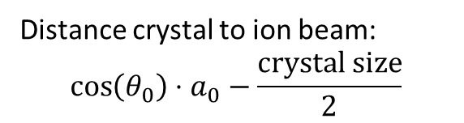

Geometry 1
ions
Approximated crystal size = $\frac{perp}{\sin{(θ_{0})}}$
$$α_{1}$$
$$α_{2}$$
$$h_{cam}$$
offset
Distance crystal to ion beam:
$$\cos\left(θ_{0}\right)⋅a_{0}−\frac{\text{crystal} \text{size}}{2}$$
$$a_{0}$$
$$\sin{(θ_{0})⋅a_{0}}$$
$$l_{cam}$$
$$b_{0}$$
$$θ_{0}$$
$$\cos\left(θ_{0}\right)⋅a_{0}$$
$$\text{p}\text{erp}\text{=}\left(\left|\tan{(θ_{0}−α_{2})}\right|+\left|\tan{(α_{1}−θ_{0})}\right|\right)⋅a_{0}$$

Slide 30

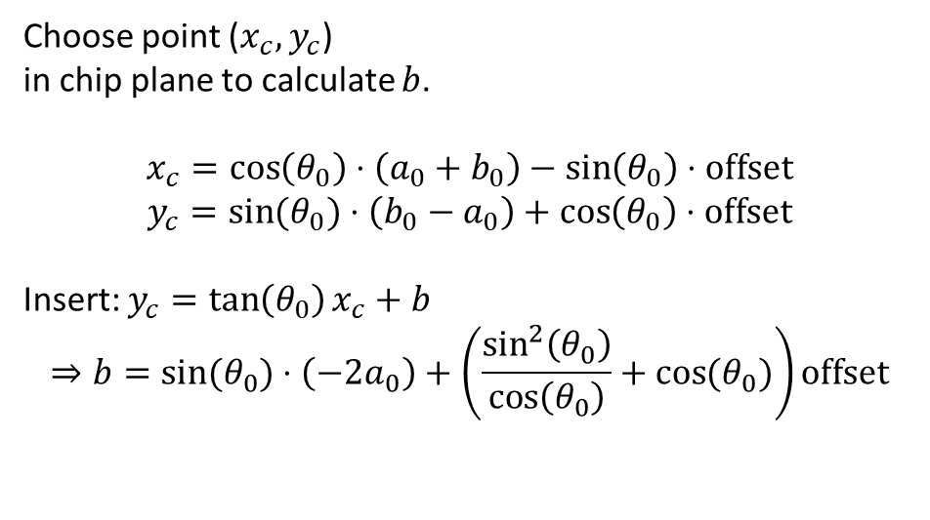

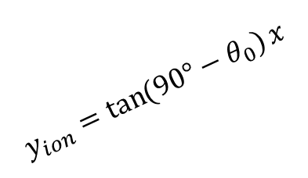
Geometry 2
$$y_{ion}=\tan{(90°−θ_{0})}x$$
$$y_{conn}=\tan\left(θ_{0}\right)x+b$$
(0,0)
$$h_{cam}$$
offset
ions
.
Choose point ($x_{c},y_{c}$)
in chip plane to calculate $b$.
$$x_{c}=\cos\left(θ_{0}\right)⋅\left(a_{0}+b_{0}\right)−\sin\left(θ_{0}\right)⋅offset$$
$$y_{c}=\sin{(θ_{0})}⋅\left(b_{0}−a_{0}\right)+\cos\left(θ_{0}\right)⋅offset$$
Insert: $y_{c}=\tan\left(θ_{0}\right)x_{c}+b$
$$⇒b=\sin{(θ_{0})}⋅\left(−2a_{0}\right)+\left(\frac{\sin^{2}\left(θ_{0}\right)}{\cos\left(θ_{0}\right)}+\cos{(θ_{0})}\right)offset$$
$$a_{0}$$
($x_{c},y_{c}$)
$$\sin{(θ_{0})⋅a_{0}}$$
$$b_{0}$$
$$θ_{0}$$
$$\cos\left(θ_{0}\right)⋅a_{0}$$

Slide 31


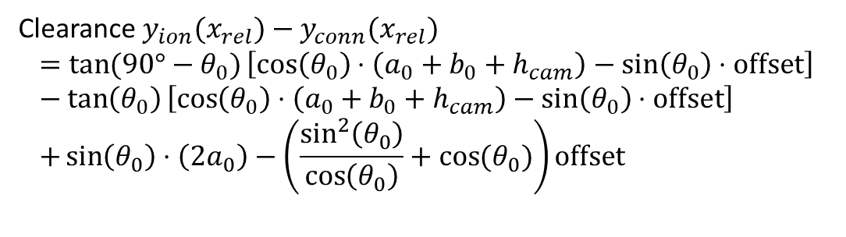
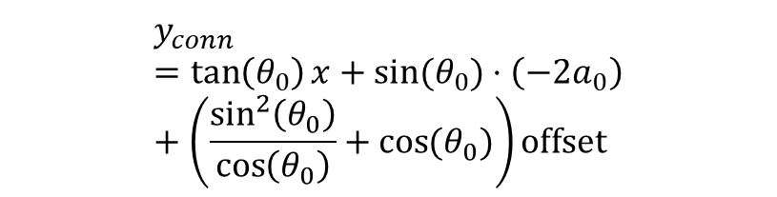
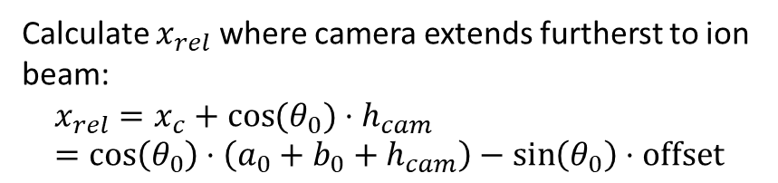
Geometry 2
clearance $y_{ion}(x_{rel})−y_{conn}(x_{rel})$
$$y_{conn}=\tan\left(θ_{0}\right)x+\sin{(θ_{0})}⋅\left(−2a_{0}\right)+\left(\frac{\sin^{2}\left(θ_{0}\right)}{\cos\left(θ_{0}\right)}+\cos{(θ_{0})}\right)offset$$
$$y_{ion}=\tan{(90°−θ_{0})}x$$
(0,0)
$$h_{cam}$$
offset
ions
.
Calculate $x_{rel}$ where camera extends furtherst to ion beam:
$$x_{rel}=x_{c}+\cos{(θ_{0})}⋅h_{cam}=\cos\left(θ_{0}\right)⋅\left(a_{0}+b_{0}+h_{cam}\right)−\sin\left(θ_{0}\right)⋅offset$$
$$a_{0}$$
($x_{c},y_{c}$)
$$\sin{(θ_{0})⋅a_{0}}$$
Clearance $y_{ion}(x_{rel})−y_{conn}(x_{rel})$
$$=\tan{(90°−θ_{0})}\left[\cos\left(θ_{0}\right)⋅\left(a_{0}+b_{0}+h_{cam}\right)−\sin\left(θ_{0}\right)⋅offset\right]−\tan\left(θ_{0}\right)\left[\cos\left(θ_{0}\right)⋅\left(a_{0}+b_{0}+h_{cam}\right)−\sin\left(θ_{0}\right)⋅offset\right] \\ +\sin\left(θ_{0}\right)⋅\left(2a_{0}\right)−\left(\frac{\sin^{2}\left(θ_{0}\right)}{\cos\left(θ_{0}\right)}+\cos{(θ_{0})}\right)offset$$
$$b_{0}$$
$$θ_{0}$$
$$\cos\left(θ_{0}\right)⋅a_{0}$$
$$x_{rel}$$

Slide 32
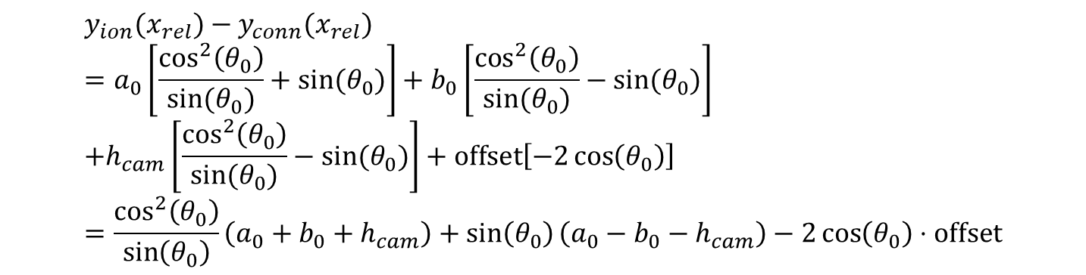
$$y_{ion}(x_{rel})−y_{conn}(x_{rel}) \\ =a_{0}\left[\frac{\cos^{2}\left(θ_{0}\right)}{sin⁡(θ_{0})}+sin⁡(θ_{0})\right]+b_{0}\left[\frac{\cos^{2}\left(θ_{0}\right)}{sin⁡(θ_{0})}−sin⁡(θ_{0})\right] \\ +h_{cam}\left[\frac{\cos^{2}\left(θ_{0}\right)}{sin⁡(θ_{0})}−sin⁡(θ_{0})\right]+offset\left[−2\cos\left(θ_{0}\right)\right] \\ =\frac{\cos^{2}\left(θ_{0}\right)}{\sin\left(θ_{0}\right)}\left(a_{0}+b_{0}+h_{cam}\right)+\sin\left(θ_{0}\right)\left(a_{0}−b_{0}−h_{cam}\right)−2\cos\left(θ_{0}\right)⋅offset$$

Slide 33
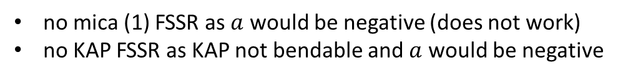
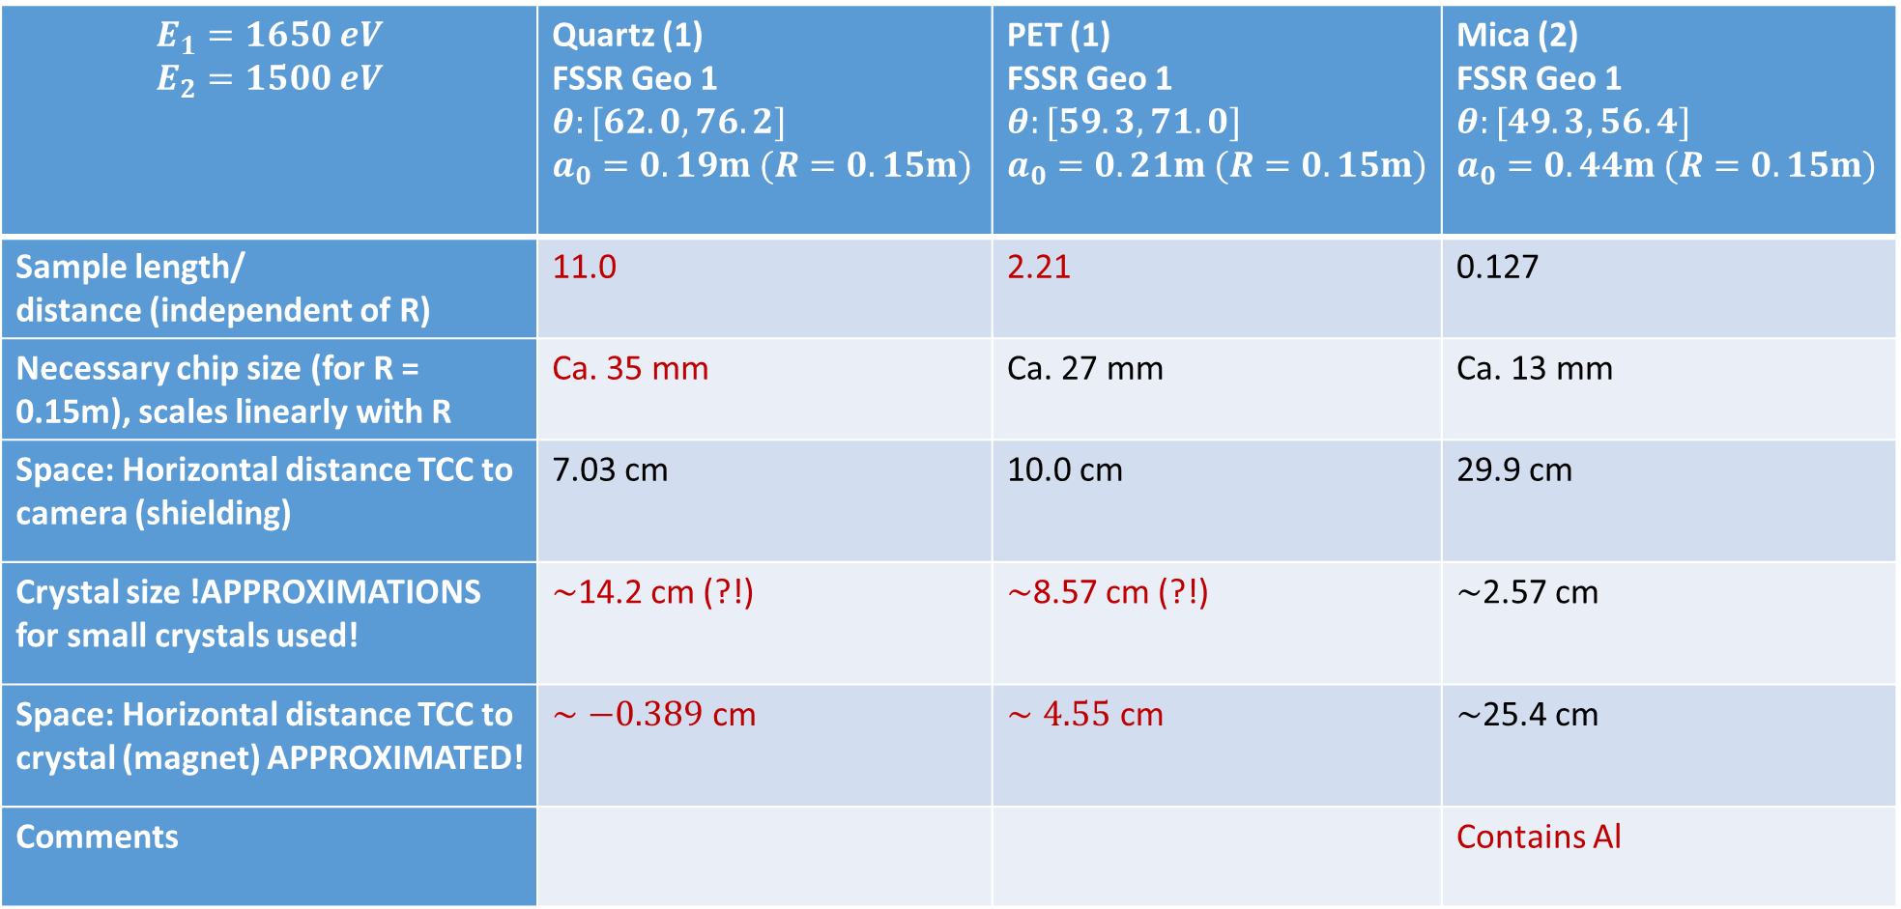
$$E_{1}=1650 eV$$ $$E_{2}=1500 eV$$ | Quartz (1) FSSR Geo 1 $$θ:[62.0, 76.2]$$ $$a_{0}=0.19m (R=0.15m)$$ | PET (1) FSSR Geo 1 $$θ:[59.3, 71.0]$$ $$a_{0}=0.21m (R=0.15m)$$ | Mica (2) FSSR Geo 1 $$θ:[49.3, 56.4]$$ $$a_{0}=0.44m (R=0.15m)$$
Sample length/ distance (independent of R) | 11.0 | 2.21 | 0.127
Necessary chip size (for R = 0.15m), scales linearly with R | Ca. 35 mm | Ca. 27 mm | Ca. 13 mm
Space: Horizontal distance TCC to camera (shielding) | 7.03 cm | 10.0 cm | 29.9 cm
Crystal size !APPROXIMATIONS for small crystals used! | $∼$14.2 cm (?!) | $∼$8.57 cm (?!) | $∼$2.57 cm
Space: Horizontal distance TCC to crystal (magnet) APPROXIMATED! | $∼−0.389$ cm | $∼4.55$ cm | $∼$25.4 cm
Comments |  |  | Contains Al
no mica (1) FSSR as $a$ would be negative (does not work)
no KAP FSSR as KAP not bendable and $a$ would be negative

Slide 34

$$E_{1}=1650 eV$$ $$E_{2}=1500 eV$$ | Quartz (1) FSSR Geo 2 $$θ:[62.0, 76.2]$$ $$a_{0}=0.19m (R=0.15m)$$ | PET (1) FSSR Geo 2 $$θ:[59.3, 71.0]$$ $$a_{0}=0.21m (R=0.15m)$$ | Mica (2) FSSR Geo 2 $$θ:[49.3, 56.4]$$ $$a_{0}=0.44m (R=0.15m)$$
Sample length/ distance (independent of R) | 0.705 | 0.370 | 0.0464
Necessary chip size (for R = 0.15m), scales linearly with R | Ca. 35 mm | Ca. 27 mm | Ca. 13 mm
Crystal size !APPROXIMATIONS for small crystals used! | $∼$14.2 cm (?!) | $∼$8.57 cm (?!) | $∼$2.57 cm
Space: Distance ion beam to water connectors (chip perp. to X-rays) | -8.87 cm | -2.92 cm | 41.6 cm
Comments | Space for magnet and shielding? | Space for magnet and shielding? | Space for magnet and shielding? Contains Al
no mica (1) FSSR as $a$ would be negative (does not work)
no KAP FSSR as KAP not bendable and $a$ would be negative

Slide 35

$$E_{1}=1600 eV$$ $$E_{2}=1550 eV$$ | Quartz (1) FSSR Geo 1 $$a_{0}=0.19m (R=0.15m)$$ | PET (1) FSSR Geo 1 $$a_{0}=0.22m (R=0.15m)$$ | Mica (2) FSSR Geo 1 $$a_{0}=0.46m (R=0.15m)$$
Sample length/ distance (independent of R) | 1.40 | 0.59 | 0.040
Necessary chip size (for R = 0.15m), scales linearly with R | Ca. 11 mm | Ca. 9 mm | Ca. 4.5 mm
Space: Horizontal distance TCC to camera (shielding) | 8.0 cm | 10.7 cm | 31.0 cm
Crystal size !APPROXIMATIONS for small crystals used! | $∼4.07$ cm | $∼$2.64 cm | $∼0.84$ cm
Space: Horizontal distance TCC to crystal (magnet) APPROXIMATED! | $∼5.3$ cm | $∼8.1$ cm | $∼$27.3 cm
Comments |  |  | Contains Al

Slide 36

$$E_{1}=1600 eV$$ $$E_{2}=1550 eV$$ | Quartz (1) FSSR Geo 2 $$a_{0}=0.19m (R=0.15m)$$ | PET (1) FSSR Geo 2 $$a_{0}=0.22m (R=0.15m)$$ | Mica (2) FSSR Geo 2 $$a_{0}=0.46m (R=0.15m)$$
Sample length/ distance (independent of R) | 0.19 | 0.11 | 0.015
Necessary chip size (for R = 0.15m), scales linearly with R | Ca. 11 mm | Ca. 9 mm | Ca. 4.5 mm
Crystal size !APPROXIMATIONS for small crystals used! | $∼4.07$ cm | $∼$2.64 cm | $∼0.84$ cm
Space: Distance ion beam to water connectors (chip perp. to X-rays) | -7.1 cm | -1.44 cm | 44.0 cm
Comments | Space for magnet and shielding? | Space for magnet and shielding? | Space for magnet and shielding? Contains Al
Mica (2) still seems to work.
How about Quartz (1) and PET (1) with larger radii? Is crystal size still fine? Is there any spherical PET?

Slide 37


space for shielding
Spectrometer
Spatial resolution desired
High intensity necessary
chip (27mm) for 1500eV- 1650eV spectral range
<1eV resolution
ions
laser
Backlighter
Sample:
at least 3 mm from backlighter
not larger than 1 mm
space for magnet
$$θ_{2}$$
$$θ_{1}$$

Slide 38
Questions
Did we understand correctly that FSSR spectral resolution is not decreased by backlighter source size?
What is the limit of crystal size (for FSSR)?
How should the detector be oriented (for FSSR): perp. to X-rays or tangent. to Rowland circle?
Which of backlighter or sample should be in imaging point (for FSSR and von Hamos)?
How strongly decreases imaging cap. of FSSR away from optimized wavelength?
Mica 2nd order FSSR? How bad is absorption from Al in mica?
KAP 2nd order flat (Geo 1) ? How efficient?
Is it generally manufacturable: spherical PET with 9cm crystal size? Is PET robust enough for ion beam exp?
EDDT?
Intensities and resolution of crystals? int: quartz < EDDT < PET. res: quartz>EDDT,PET
Spectral/spatial resolution: can you recommend any ray tracing code?
Notes:
Check if PET 1st order FSSR might work.

Slide 39
Alternative geometries

Slide 40


$$λ=λ_{0}\cos{φ} \\ E_{1}=1600 eV, λ_{1}=7.749e−10 m$$
$$E_{2}=1550 eV, λ_{2}=7.999e−10 m$$
$$⇒φ=\arccos{\frac{7.749}{7.999}}=14.4°$$
Breite des Spektrums in z.B. 10cm Abstand:
$$width=\tan{14.4°}⋅10cm=2.6cm$$

Slide 41
Laser

